Slide 1
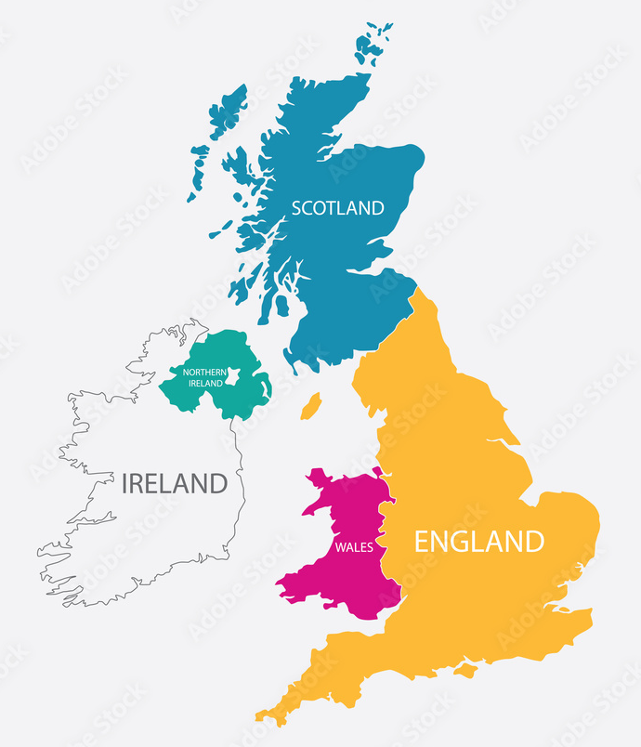
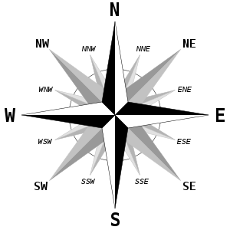
Why are some places more popular for beach holiday than others? - Geography
Key Vocabulary
coast | The coast is an area of land that is next to the sea.
coastline | A country's coastline is the outline of its coast.
weathering | The breakdown of rocks by the action of rain, snow, cold, etc
erosion | The gradual destruction and removal of rock or soil in a particular area by rivers, the sea, or the weather.
headland | A headland is a narrow piece of land which sticks out from the coast into the sea.
arch | An arch is a structure that is curved at the top and is supported on either side by a pillar of rock.
cave | A cave is a large hole in the side of a cliff.
stack | A tall column of rock left behind when the top of an arch structure collapses.
stump | A small column of rock left behind when a stack collapses.
pebble | A large lump of rock made smooth by weathering and erosion,
sand | Tiny particles of rock.
UK
Compass
Coastline

Slide 2
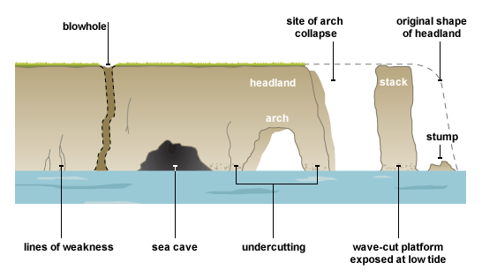
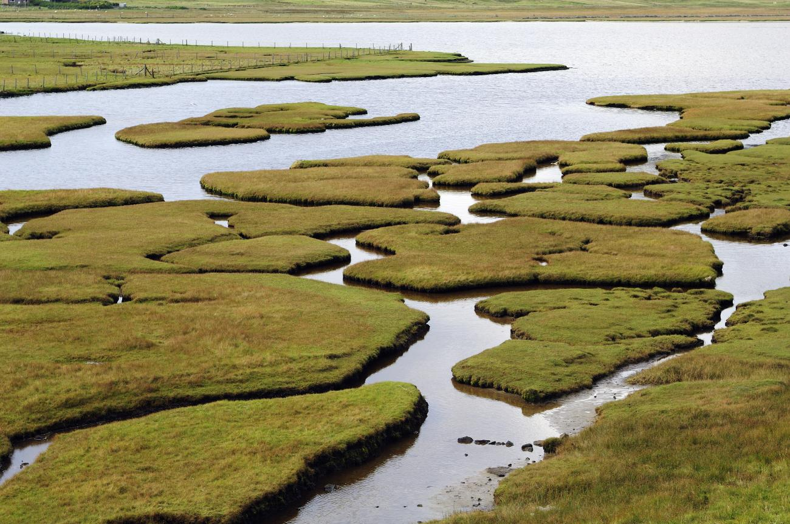
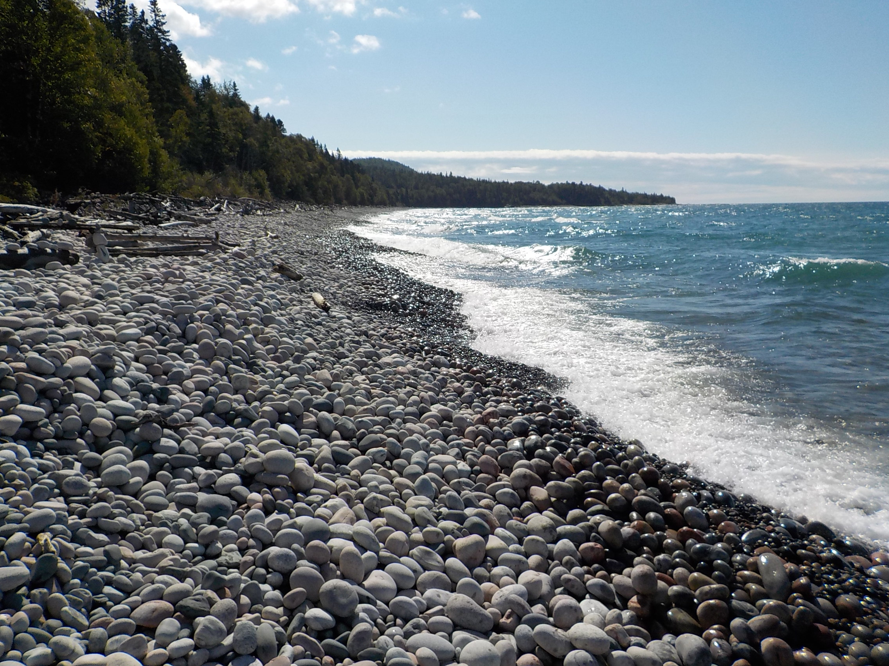
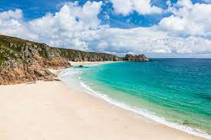
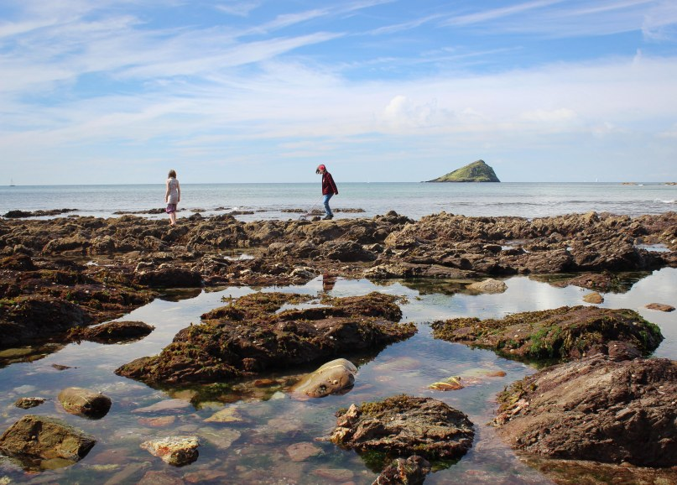
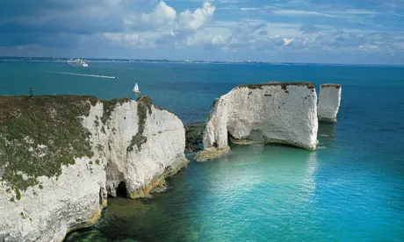
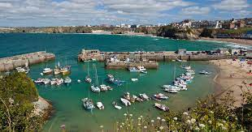
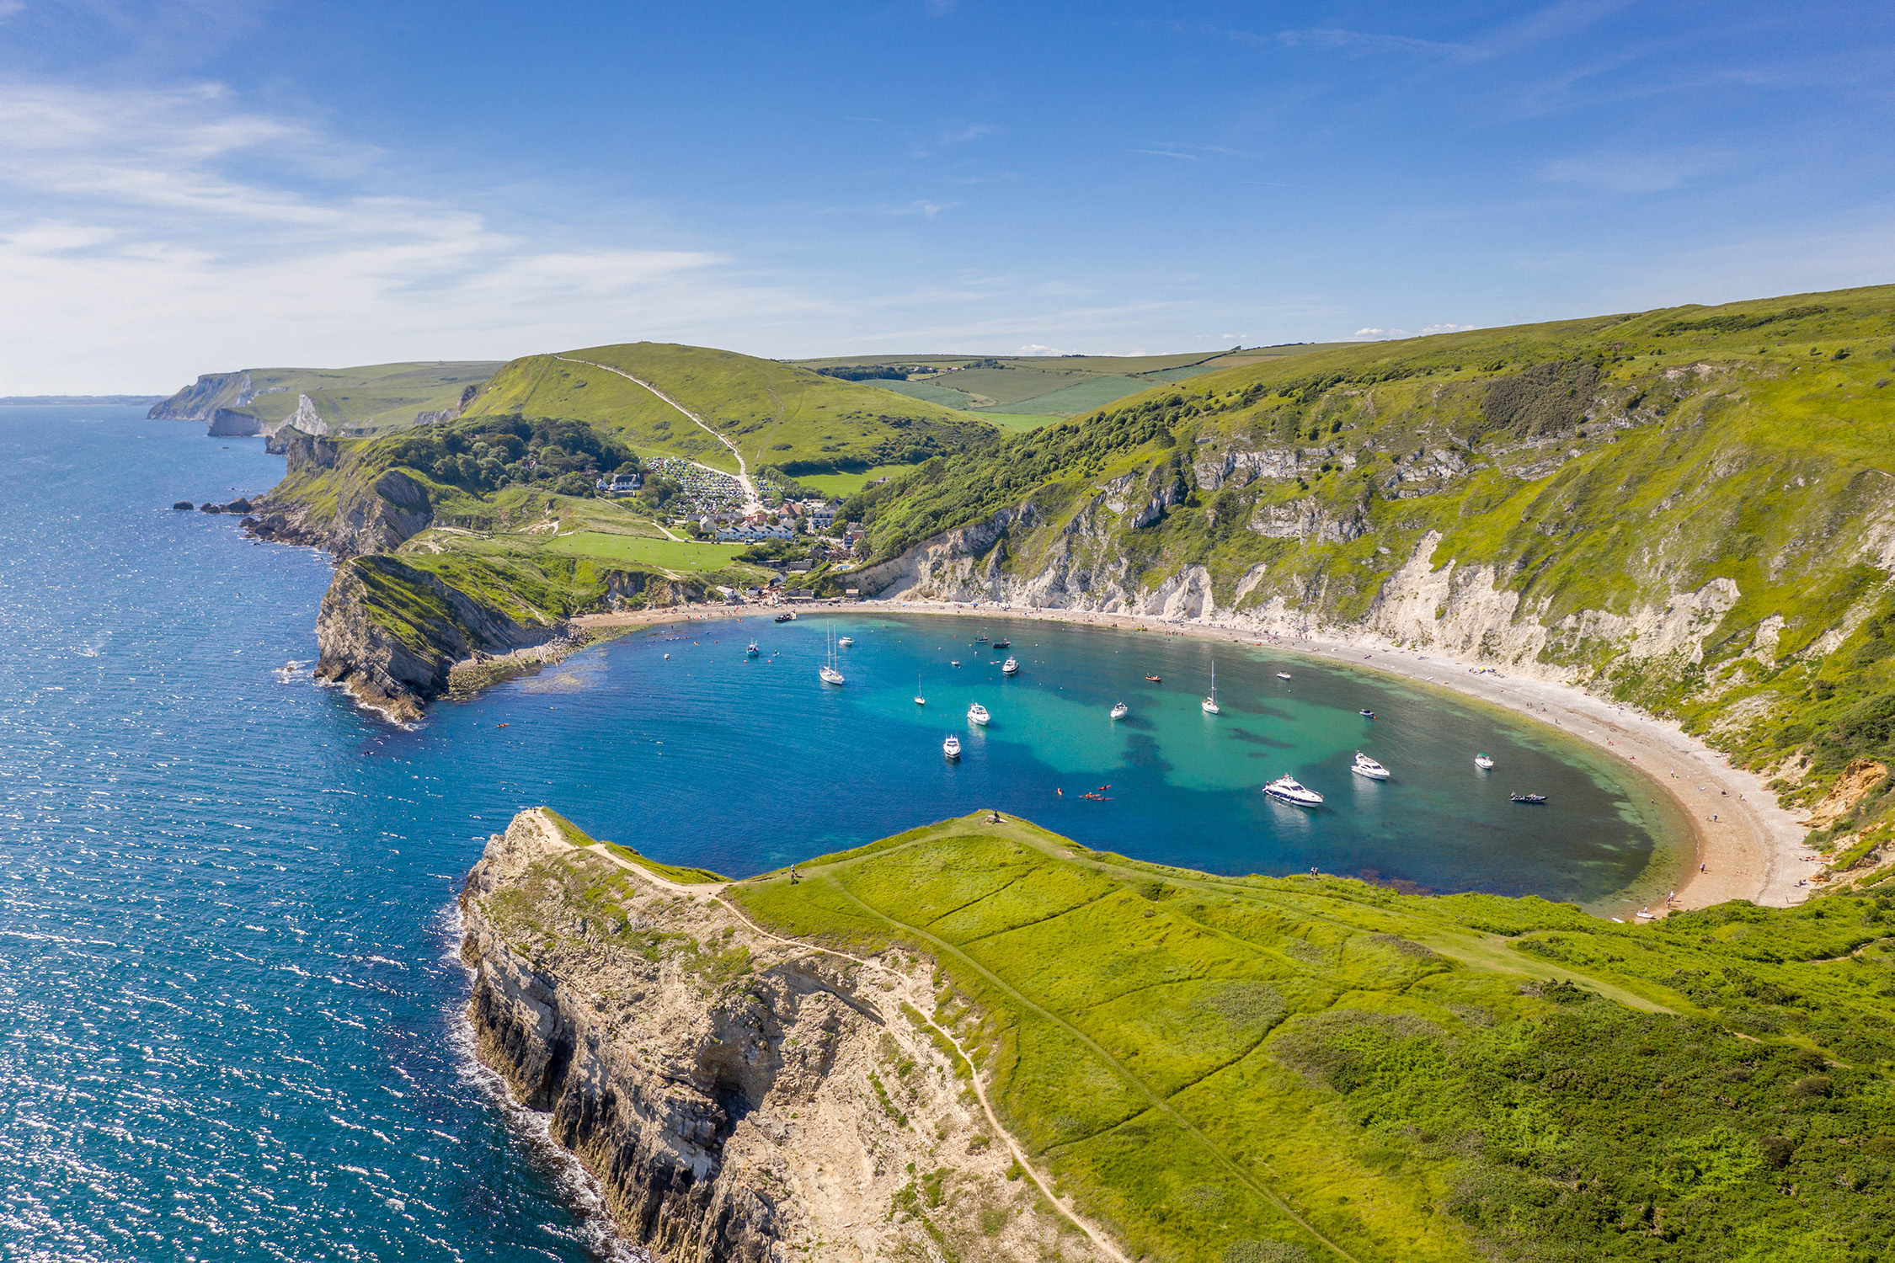
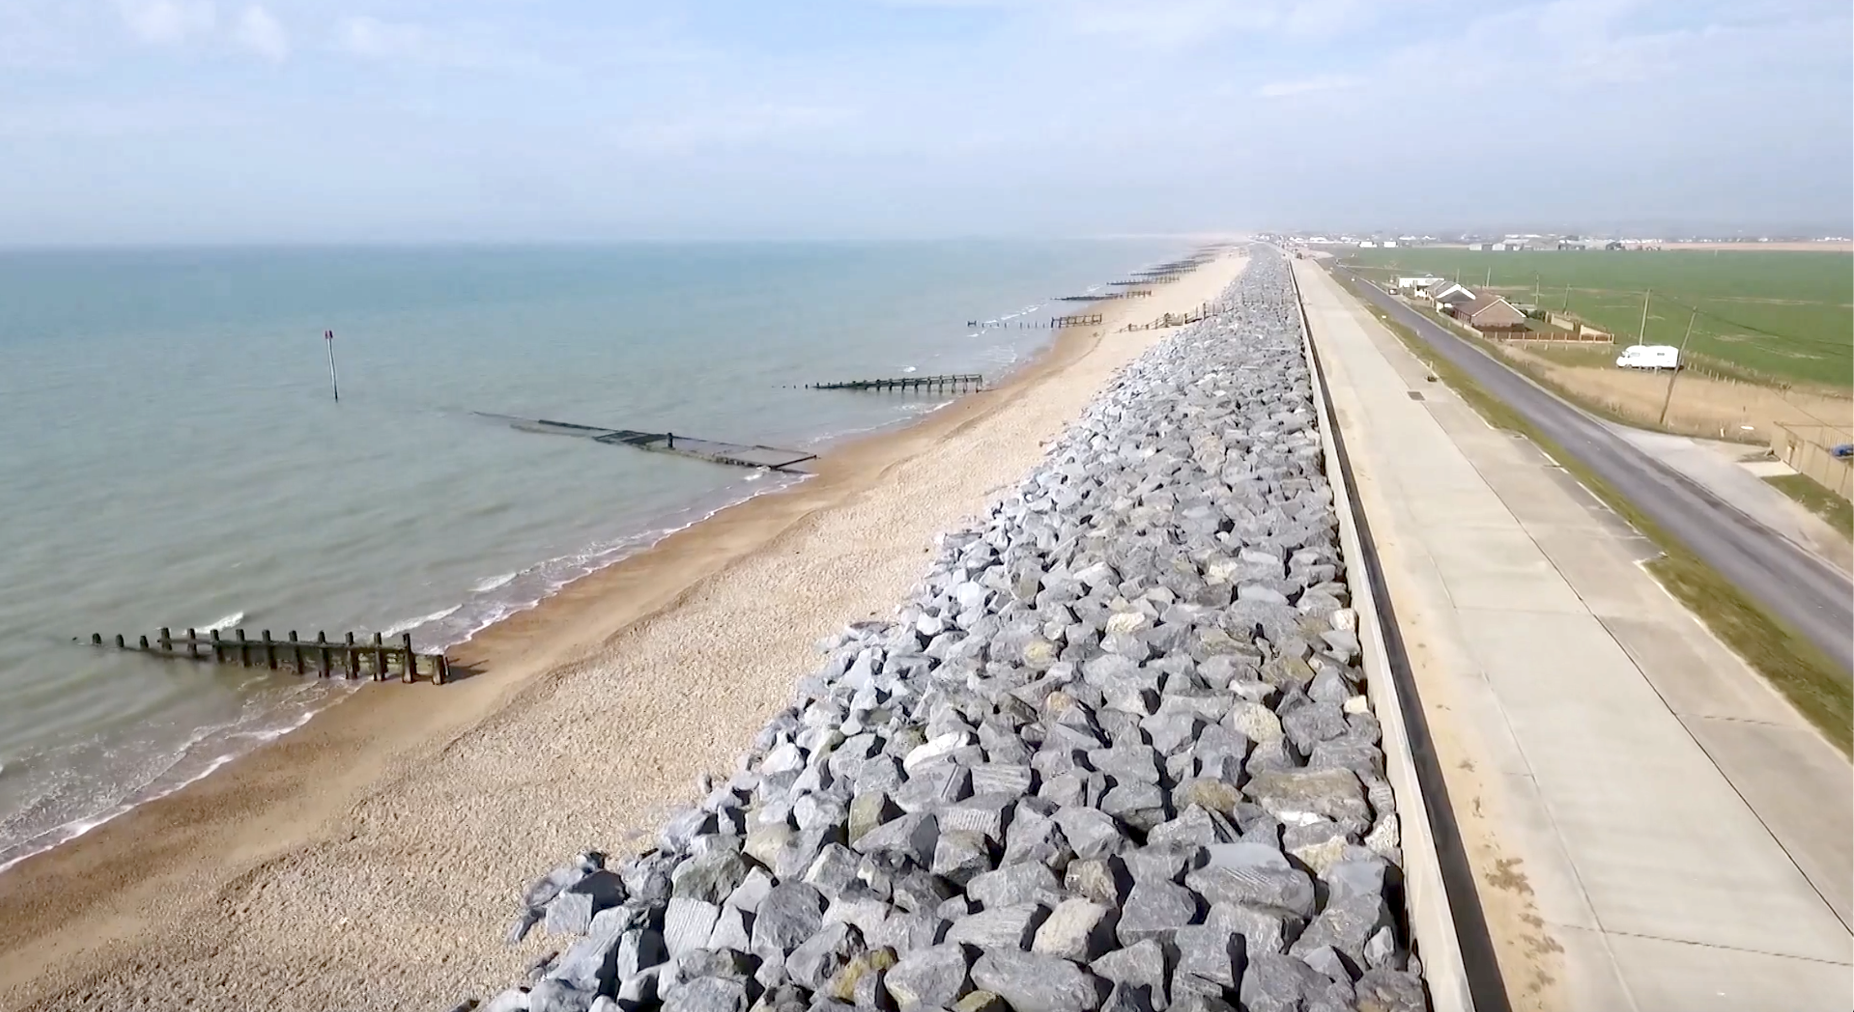
Key Facts
The 4 main points on a compass are North, South, East and West. These can further be divided into North-East, South-East, South-West, North-West.
The landforms that develop along the coast are the result of a combination of processes acting upon the sediment and rocks along the coast. The most damaging of these processes are waves and weather.
The UK coastline is approximately 7,723 miles long.
Different coastal features show coasts at different stages of erosion.
A headland is created because the rock is much harder and erodes much more slowly than the land made up of softer rock.
Salt marshes are coastal wetlands that are flooded and drained by salt water brought in by the tides.
Coastal Landforms
Types of coast
Salt Marsh Pebble Sand Rock
Cliff Harbour Cove Flood defences

