Slide 1
Art – Cyanotypes Focus on English Photographer and Botanist, Anna Atkins
Key Vocabulary
photography | Method of recording the image of an object through the action of light.
exposure | (specifically for this) the amount of time that light is shining on our work
material | The items needed to make or do something
hue | Colour or shade (hues of blue in cyanotype)
develop | Grow or change (the image will develop when rinsed with water).
permanent | Lasts unchanged forever
photographer | A person who takes photographs
botanist | A person who studies (learns about) plants
photograph | An image created by light falling on a photosensitive surface
photogram | A photographic image made without a camera
Key facts
Cyanotypes were invented in 1842 – the same process is used today.
Anna Atkins created the first ever photography book published in 1843
The cyanotype will start to develop as soon as it is exposed to light. You must keep it in the dark until you are ready to use create your image.
Cyanotypes are usually printed using the power of the sun.
Cyanotypes can be created with any opaque or translucent objects. Anna Atkins used natural objects.
Appropriate PPE (gloves + goggles) must be worn when handling the chemicals. Children must not use the chemicals unsupervised.

Slide 2
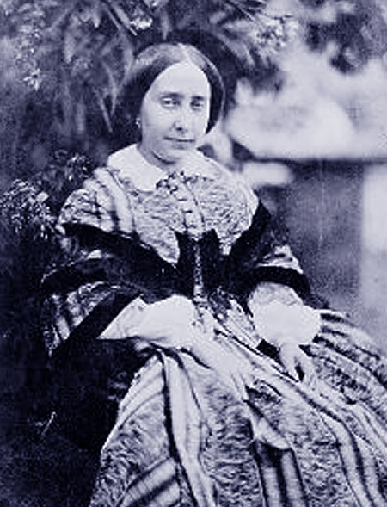
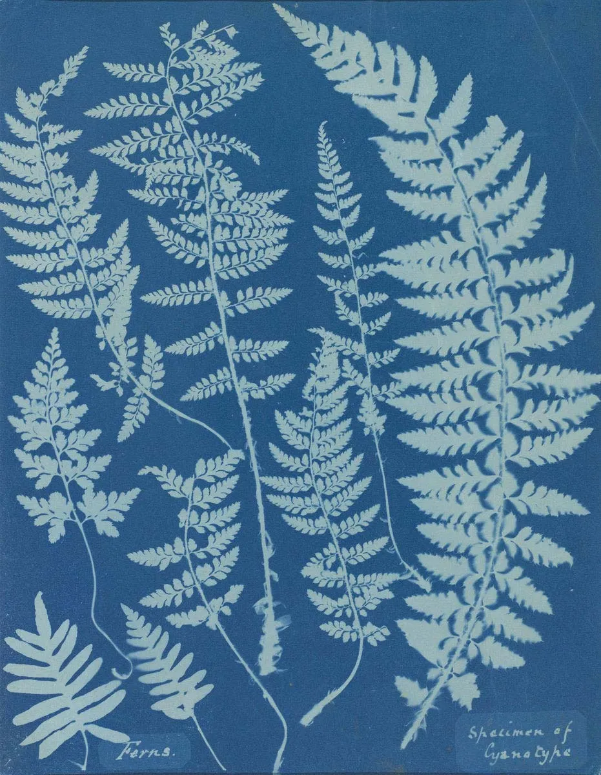
This cyanotype was created by Anna Atkins in the 1840s. It still looks the same today as it did almost 200 years ago!
Images
Photograph of Anna Atkins (date unknown)
Cyanotype process with objects
Tier 2 vocabulary
create | To make something.
communicate | Share or exchange information, news or ideas.
unique | The only one of its kind.
environment | The surroundings in which an animal or plant.
design | Plan or draw something to show how it will look.

Slide 3
Lessons https://jostephen.photography/how-to-make-wet-cyanotypes/ teacher to read in advance of teaching. And watch this for the solargraphy tutorial
Look at some of Anna Atkins’ cyanotypes. What do we like about them? What are they? Opportunity for retrieval from Kestrel Class work
Remind children that exposure to light is essential in photography – you are recording light.
Review cyanotypes in sketch book from Kestrel Class. What was effective? If not identified, refer to negative space.
Teacher to decide whether to repeat traditional cyanotype process again at this point – or introduce ‘wet cyanotype’ process
Take children on a tour of grounds, looking for interesting natural objects (leaves which create interesting negative space, feathers and other relatively flat objects will work best). Bring back to class and try to sketch in sketchbooks – see p31 DCA for more guidance). Keep found items – pressing leaves etc would also benefit future lesson if possible (not essential)
Introduce book – The Bluest of Blues. 1:1 with children coat a sheet of white paper (ideally watercolour). (Write name in pencil on reverse of paper in order to identify later and to not become washed off during process). Can experiment with brush strokes or coat whole paper. This needs to be done in a relatively dimly lit space (classroom with lights off is fine – or turn role-play area into a ‘lab’). Coated paper needs to dry and be kept in a dark place until used in future lesson. Ideally coat a couple of small pieces and a larger piece per child.
Need a bright, calm day day. Children to place their objects onto paper and expose in the sun. There is no set time for exposure, it is dependent on the strength of the sun. The yellow/green paper will turn grey. Wait for 10 seconds after it is grey before developing (the exact time is not essential with photograms, better to over expose than under).
As soon as you are happy it is exposed, remove the objects and rinse in water until the paper runs clear (wear rubber gloves whilst rinsing). Leave to dry. The image will become a richer hue of blue as the image dries and it is exposed to oxygen. The image is no longer light sensitive.
Extension – you can use natural substances to tone your cyanotypes. Tea, coffee, green tea and rooibos all produce different colours and can change your cyanotypes from blue. Simply soak your original cyanotype in water and then move to your chosen toning liquid. Leave as long or as a short a time as you like. Darker tones = longer time
Cyanotype will also work on natural fabric. You could coat a piece of fabric and get the children to place hands etc on the fabric whilst it exposes (this does involve them not moving!).
Repeat 4 & 5 with different exposure lengths for different tones or with different found objects.
Display work as an art exhibition for parents

